Slide 1
Analysis of physical activity/Obesity and Nutrition across different age groups in the US

Slide 2
Objectives
Analysis on physical activity in relation to obesity and overweight conditions
Eating habits in relation to fruit and vegetables consumption
Notes:
Analysis of physical activity across different age groups in the years 2020, 2021, and 2022 in the US. The scope of our analysis will focus on physical activity in relation to obesity and overweight conditions, percent of adults who engage in no leisure-time physical activity, and eating habits in relation to fruit and vegetables consumption. Our findings will identify where the US, as a whole, falls in obesity and overweight, and fruit and vegetables consumption. It will also identify the highest and lowest ranking US state in these two categories among different age groups. The data findings will be used to identify a possible correlation between physical activity and eating habits. This analysis could be a useful tool for US federal and state agencies to develop customized programs to support states with a higher risk of developing obesity-related conditions
Our analysis was run by the API from The Behavioral Risk Factor Surveillance System (BRFSS). The BRFSS is the US system of health-related telephone surveys that collects state data about U.S. residents regarding their health-related risk behaviors, chronic health conditions, and use of preventive services.

Slide 3
Physical activity in relation to obesity and overweight conditions

Slide 4
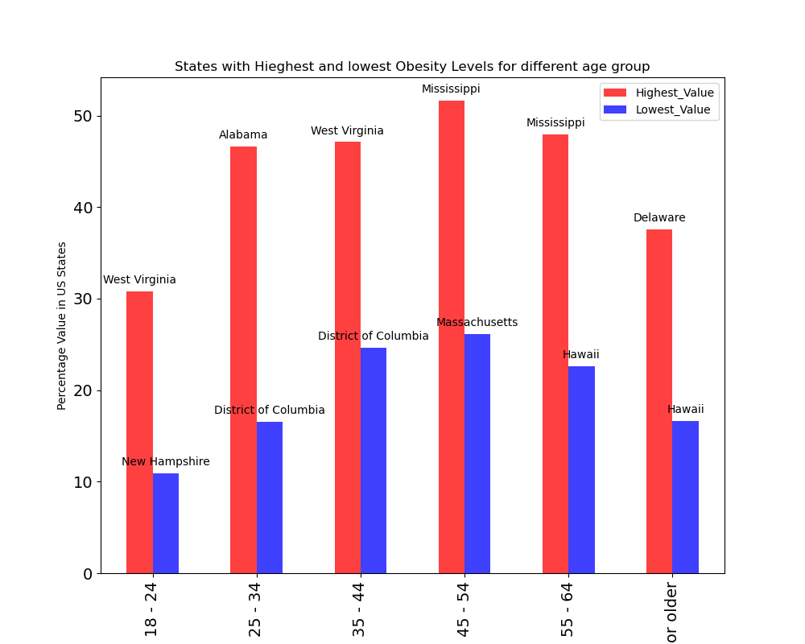
Observing the mean value of Obesity percentage for different age-groups we can see that obesity percentage generally increase with age especially peaking in the 45 - 54 age range. (The higher the mean value the possibilities of obesity is more on that age-group)

Slide 5
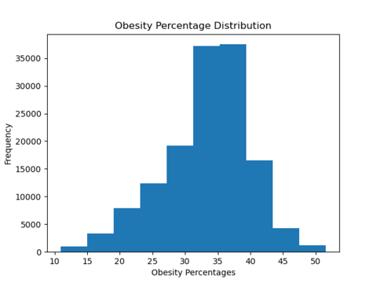
Distribution Symmetry: Median values are close to the mean in most age groups, suggesting a generally symmetric distribution of obesity percentages. Slight deviations indicate possible skewness in some groups like 45-54 and 65-older.

Slide 6
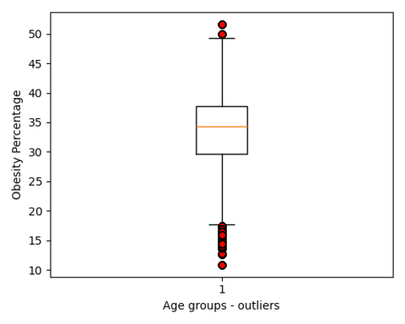
Variability: The 45-54 and 65+ age groups have the most variation in obesity percentages, showing the widest range of obesity rates among individuals in these groups.

Slide 7
Percent of adults who engage in no leisure-time physical activity

Slide 8
The sample comprises the 50 USA states with a sample size 12,000 per state based on each age group. A pie chart was used to show the number of individuals with little or no activity leading to obesity.

Slide 9
Visualization: Pie Chart
Showed a sample size of 12,000 individuals who had little or no exercise

Slide 10
Eating habits in relation to fruit and vegetables consumption

Slide 11
The US does not meet minimum requirements of fruit and vegetables as recommended by The U.S. Departments of Agriculture (USDA) and Health and Human Services (HHS). The 2020–2025 Dietary Guidelines for Americans advise adults should consume 1.5–2 cup-equivalents of fruits and 2–3 cup-equivalents of vegetables daily. Only 12-10% of surveyed adults met fruit and vegetables intake recommendations

Slide 12
On average, 29.97% of the US respondents consumes daily recommendations of fruit and vegetables. The standard deviation on this average is 8.98% which may suggest that the values in the dataset are fairly reliable

Slide 13
US states with the highest and lowest levels of fruit and vegetable consumption among different age groups

Slide 14
Fruit consumption

Slide 15
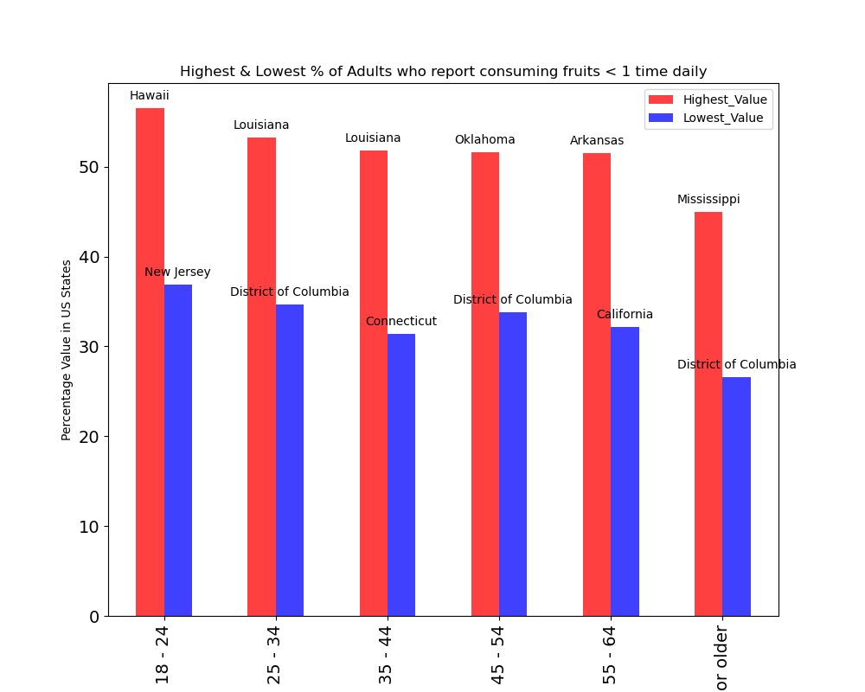
Fruit consumption
Notes:
Adults who reported consuming fruit less than once time daily (the total daily fruit consumption was calculated based on responses to questions 1 and 2: 1) 100% pure fruit juices; 2) fruit; 3) green salad; 4) fried potatoes; 5) other potatoes; and 6) other vegetables.)

Slide 16
Fruit consumption: Highest
Notes:
Adults who reported consuming fruit less than once time daily are mainly located in the southeast of the US (Oklahoma – southwest, right next to AR and LA). Age seems to play a role in the high-ranking states. It seems that the older you get, the healthier choices you make in your fruit/vegetable consumption as there is a positive decrease in percentages
The highest ranking was among the youngest of the group, and located on the West of the US (Hawaii). One factor that may have an effect on this statistic is the lack of resources because Hawaii is an island. Most islands lack of own resources and need to get products, such as food from the mainland which increases the food price. Another factor could be that most 18-24 y/o are in school or just incorporating themselves into the work force which may be an indicator of low earnings

Slide 17
Fruit consumption: Lowest
Notes:
The lowest ranking states in the fruit intake group are also mainly located in the southeast of the US. The main difference is being geographically located to the east of the country (DC). Here we also see a pattern of decreasing percentages as respondents get older, that with the exception of the 45-54 age group.

Slide 18
Vegetable consumption

Slide 19
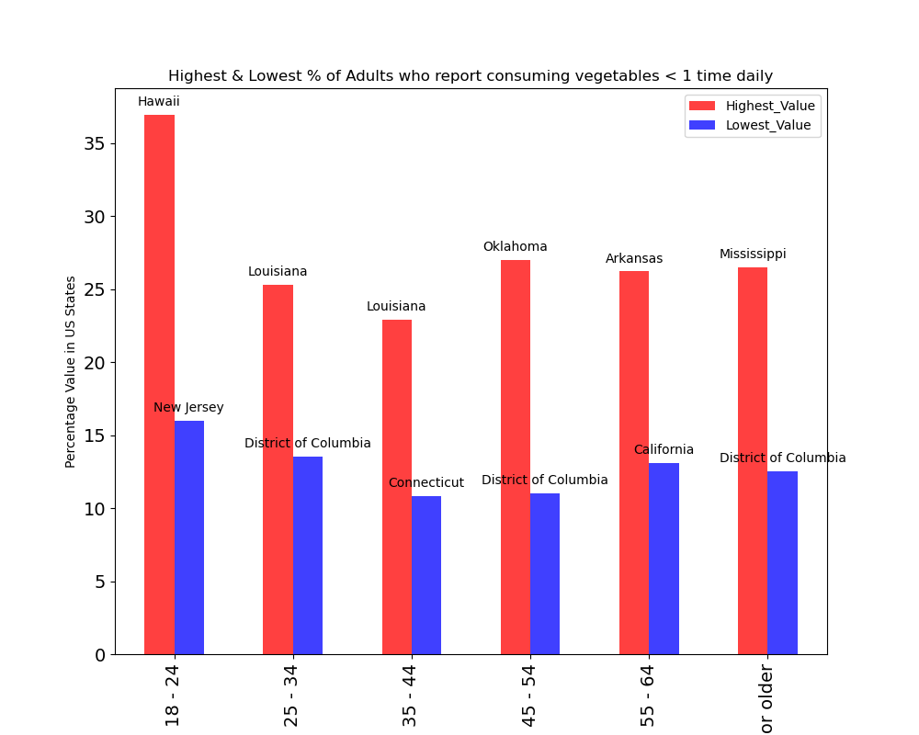
Vegetable consumption
Notes:
Adults who reported consuming vegetables less than one time daily (the total vegetables consumption was calculated based on responses to questions 3-6: 1) 100% pure fruit juices; 2) fruit; 3) green salad; 4) fried potatoes; 5) other potatoes; and 6) other vegetables.)

Slide 20
Vegetable consumption: Highest
Notes:
Adults who reported consuming vegetables less than once time daily are also located in the southeast of the US. In the contrary, the least number of adults who reported consuming vegetables less than once time daily are located in the New England region of the US (most of them being in Maine).

Slide 21
Vegetable consumption: Lowest
Notes:
Age seems to be a factor of trending down percentages from the age groups 18-25 until 35-44. Location may play an important part on this as it is noted that in the state of Louisiana the percentages went up (27%), and then went down very little in 45-54 to 65 or older

Slide 22
Correlation between fruit /vegetable consumption and age group

Slide 23
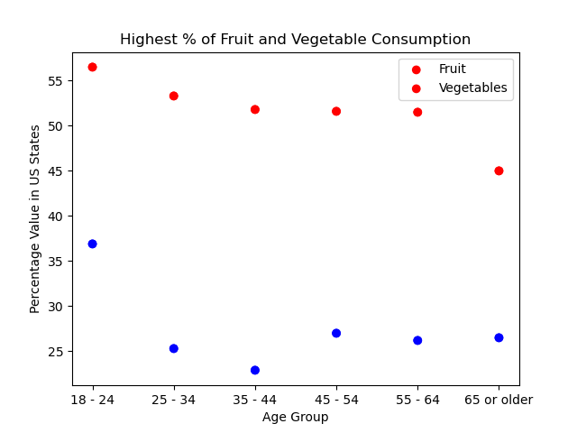
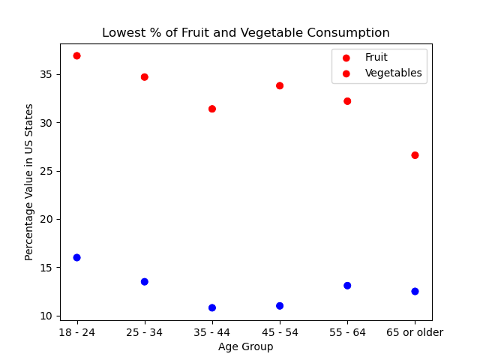
Notes:
On this slide, we have merged both, fruit and vegetables intakes. The red dots represent the fruits and the blue ones the vegetables. On the first graph “highest % of fruit/vegetables consumption”, we can see that as the respondents grow older, their fruit intake gets a bit better since their percentage of consuming less than 1 fruit serving per day is going down. On the other hand, we see that when it comes to vegetables, as the respondents move from the 18/24 to 25/34 age group bracket, there is a big dip in the percentage of consuming less than 1 vegetable serving per day (maybe higher income?). There is also another marginal dip between 25/34 to 35/44 age group. The intake seems to get steady as the respondents move from 45/54 to 65/older
On the 2nd graph “lowest % of fruit and vegetable consumption”, there is also a decrease in the percentage of consuming less than 1 fruit serving per day as the respondents get older, with the exception of a slight increase from 35/44 to 45/54 age group. When it comes to vegetables, there is also a decrease in the percentage of consuming less than 1 vegetable serving per day with the exception of the 45/54 to 55/64 age group (retirement?)

Slide 24
Barriers in fruit/vegetables consumption
Socio-economic status
Cost of fruits and vegetables
Variety and qualify of fruits and vegetables
Access
Awareness of the intake recommendation
Notes:
Level of education
Prices are rising for everything
Quality of produce is not always the best, better quality seems to fall under organic produce (lasts longer, tastes better) which is more expensive compared to the non-organic.
Taste preference when it comes to fruit over veggies (not all fruits taste the same unlike other processed foods)
The misconception that fruits as they are sweet may have more sugars and provide a less nutritional value compared to veggies (older adults)
Respondents may lack access to grocery stores or farmers markets to be able to get their produce
Nutritional education programs are not equally accessible to all

Slide 25
Limitations
The Behavioral Risk Factor Surveillance System (BRFSS) conducted a telephone survey, so the number of adults that actually took the time to complete may not be a full representation of the US population
The test results (data) were based on self-proclaimed physical and fruit/vegetable intake behaviors and not assessed by a licensed medical practitioner
Notes:
Jupyter notebook disappeared on Paola’s analysis when attempting to merge changes to the repo
We didn’t notice that our chosen API lacked valuable information until we actually did the cleaning and sorting of it

Slide 26
Conclusion
Health outcome expectations
The consumption of fruit and vegetables will decrease the chances of adults developing chronic diseases
The low consumption of fruit and vegetables leads to a higher risk of getting a chronic disease which could eventually lead to death.
Notes:
Making the call: Based on our analysis, there is a correlation between physical activity and eating habits when it comes to our health. Our findings identify a higher concentration of lack of physical activity, poor nutrition and high obesity percentages in southern states. Our recommendation includes collecting more relative professional data so that a more thorough investigation can be completed. Once additional relative information is gathered, then statistical tests such (T-tests and ANOVA) can be run to do a further analysis to better compare these different groups. Introducing food hubs, nutrition education, involving food policy councils, policies and laws would be a first good step to approach this issue. Healthy eating habits and physical activities supports the core of our immune system to prevent developing obesity-related conditions such as type 2 diabetes, high blood pressure, and coronary artery disease.
chronic diseases that can become costly to the population as well as to the states. higher risk of

